Slide 1
Language models

Slide 2
Language model
Language models estimate probabilities of various tokens:
words
letters
…
or estimate probability of token sequences:
sentences
words
...

Slide 3
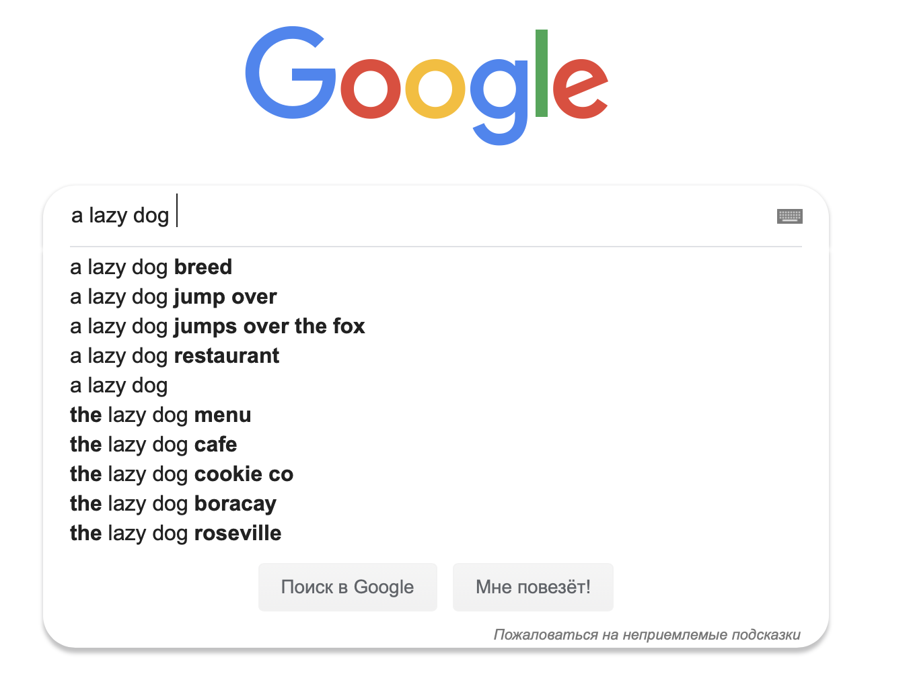
Language model

Slide 4
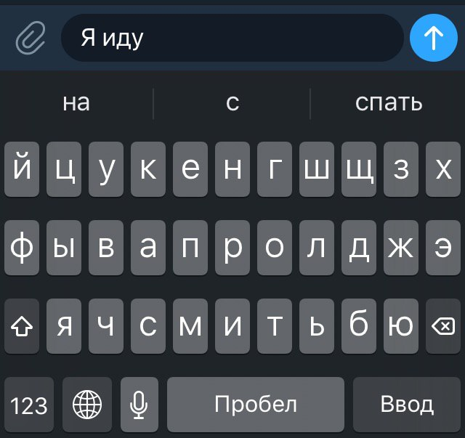
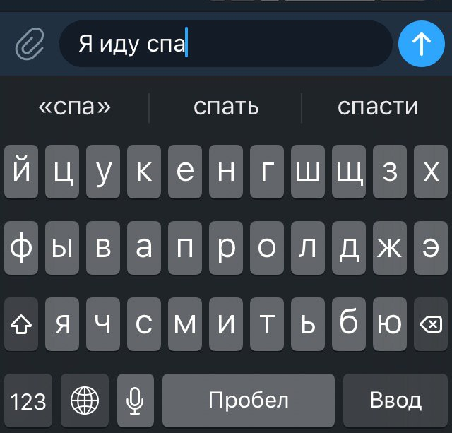
Language model

Slide 5
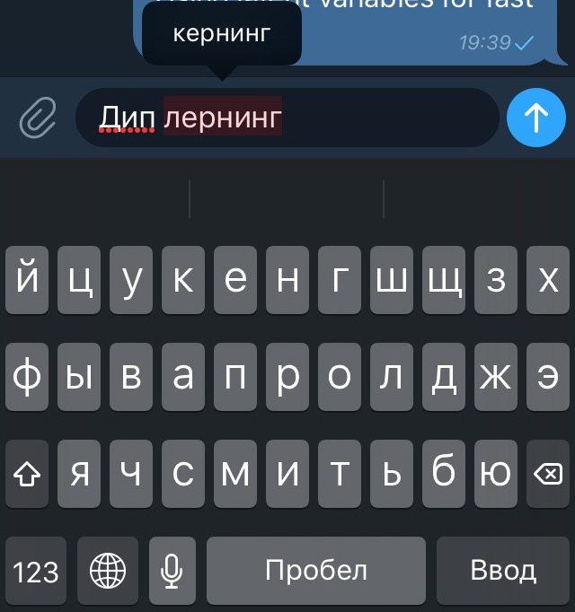
Language model

Slide 6
Language model
Token probability: how likely this token is to occur after a sequence of tokens
I am going to
Sentence probability: how likely this sentence is to occur in natural language
P(I am going to sleep) > P(I am sleep going to)
sleep
study
school

Slide 7
Language models
Count-based
Neural

Slide 8
Count-based LM

Slide 9
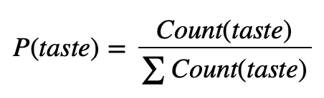
Probability estimation
Let’s count different Bertie Bott’s tastes in ten sweets pack:
Banana | Black pepper | Cinnamon | Lemon | Dirt | Earthworm | Grass
26 | 23 | 19 | 20 | 17 | 13 | 22

Slide 10
Probability estimation: sentences
we want to estimate sentence probabilities using same idea
we have large corpus of data
we want to be able to estimate probability of a sentence that we have never seen before
The Ftaghn credled raftangly spattengly
Ftagn ranght kdufbfnms msnlkvrl
P = ?

Slide 11
Probability estimation: sentences
Problems:
we always have small training data
we have many sentences that occure in training set 0 times

Slide 12
Probability estimation: sentences
Problems:
we always have small training data
we have many sentences that occure in training set 0 times
Solution:
estimate sentence probability as combination of probabilities of its smaller parts: N-gram Language model

Slide 13
Probability estimation: sentences
We want to get P(I want to sleep)
Idea #1:
P(I want to sleep) = P(w1 = I, w2 = want, w3 = to, w4 = sleep)
P(X, Y) = P(Y| X) P(X)
P(I want to sleep) = P(sleep | I want to)・P(I want to) =
= P(sleep | I want to)・P(to | I want)・P(want | I)・P(I)

Slide 14
Probability estimation: sentences
P(I want to sleep) = P(sleep | I want to)・P(I want to) =
= P(sleep | I want to)・P(to | I want)・P(want | I)・P(I)
Problem:
we still need to estimate probabilities of huge prefixes:
P(A cute little sheep was enjoying its life) =
P(life | A cute little sheep was enjoying its)・...

Slide 15



Probability estimation: sentences
Solution: Independence assumption:
next word depends only on n previous words:
trigram model:
bigram model:
unigram model:

Slide 16
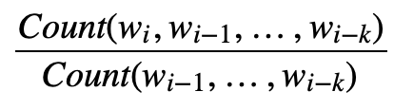
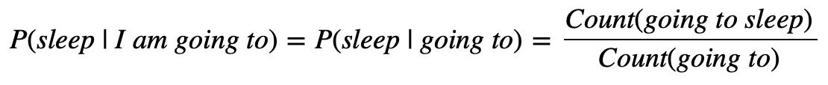
Probability estimation: sentences
Finally estimating probabilities:

Slide 17
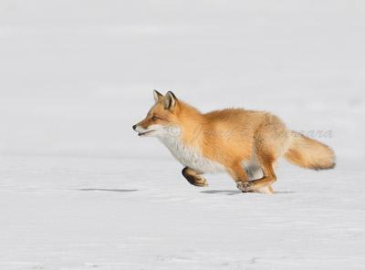
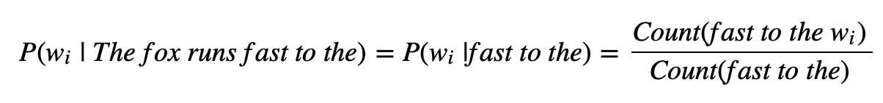
N-gram LM
The fox runs fast to the __

Slide 18
N-gram LM
Problems:
What if we didn’t see this prefix
in training set at all?

Slide 19
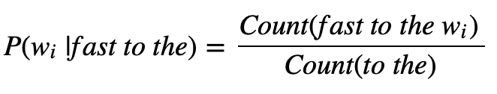
N-gram LM
Problems:
What if we didn’t see this prefix
in training set at all?
Solution: backoff:

Slide 20
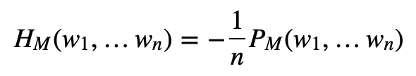
Language models
How to score language models:
Cross-entropy / perplexity
score sentences from validation set using our LM:
Put LM into another NLP system and see if this works better
(this is too complicated)

Slide 21
Bigram language model
The __

Slide 22
Bigram language model
The __
cat 0.35
dog 0.3
man 0.15
fox 0.05
clock 0.0006
onion 0.00004
go 0.00000000012

Slide 23
Bigram language model
The cat

Slide 24
Bigram language model
The cat __
lays 0.44
sits 0.12
runs 0.06
run 0.0002
stays 0.0006
onion 0.000009
go 0.000000000012

Slide 25
Bigram language model
The cat lays __

Slide 26
Neural LM

Slide 27
Neural LM
hole
rabbit
man
forest
clock
egg
road
Output distribution
NN
Embeddings
The fox runs fast to the

Slide 28
Neural LM
Advantages:
no problem with unseen words
no problem with zero probabilities
Remaining problems:
markov property
word processing depends on its position
The fox runs fast to the

Slide 29
Neural LM
hole
rabbit
man
forest
clock
egg
road
Output distribution
NN
RNN
The fox runs fast to the

Slide 30
Neural LM
hole
rabbit
man
forest
clock
egg
road
Output distribution
NN
СNN
Concatenate
The fox runs fast to the

Slide 31
LM for Embeddings
Why not to get embeddings from language model?

Slide 32
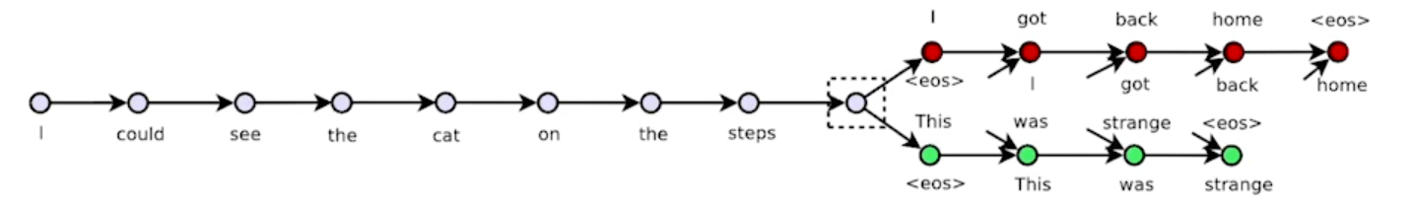
Sentence embeddings
Generate next sentence word-by-word
RNN

Slide 33
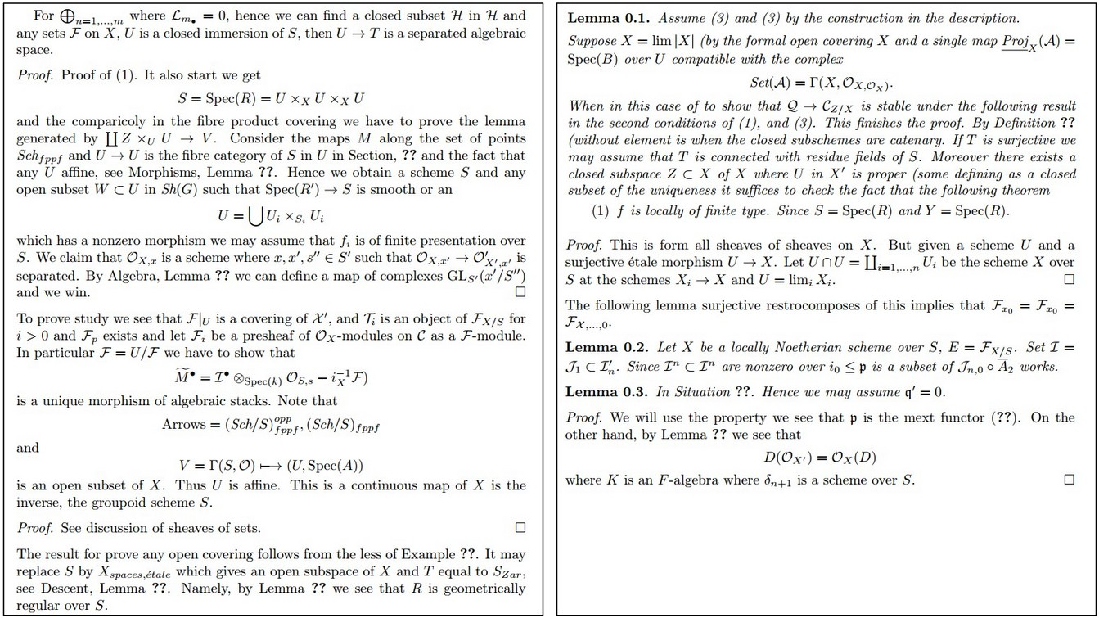
LM examples
http://karpathy.github.io/2015/05/21/rnn-effectiveness/

Slide 34
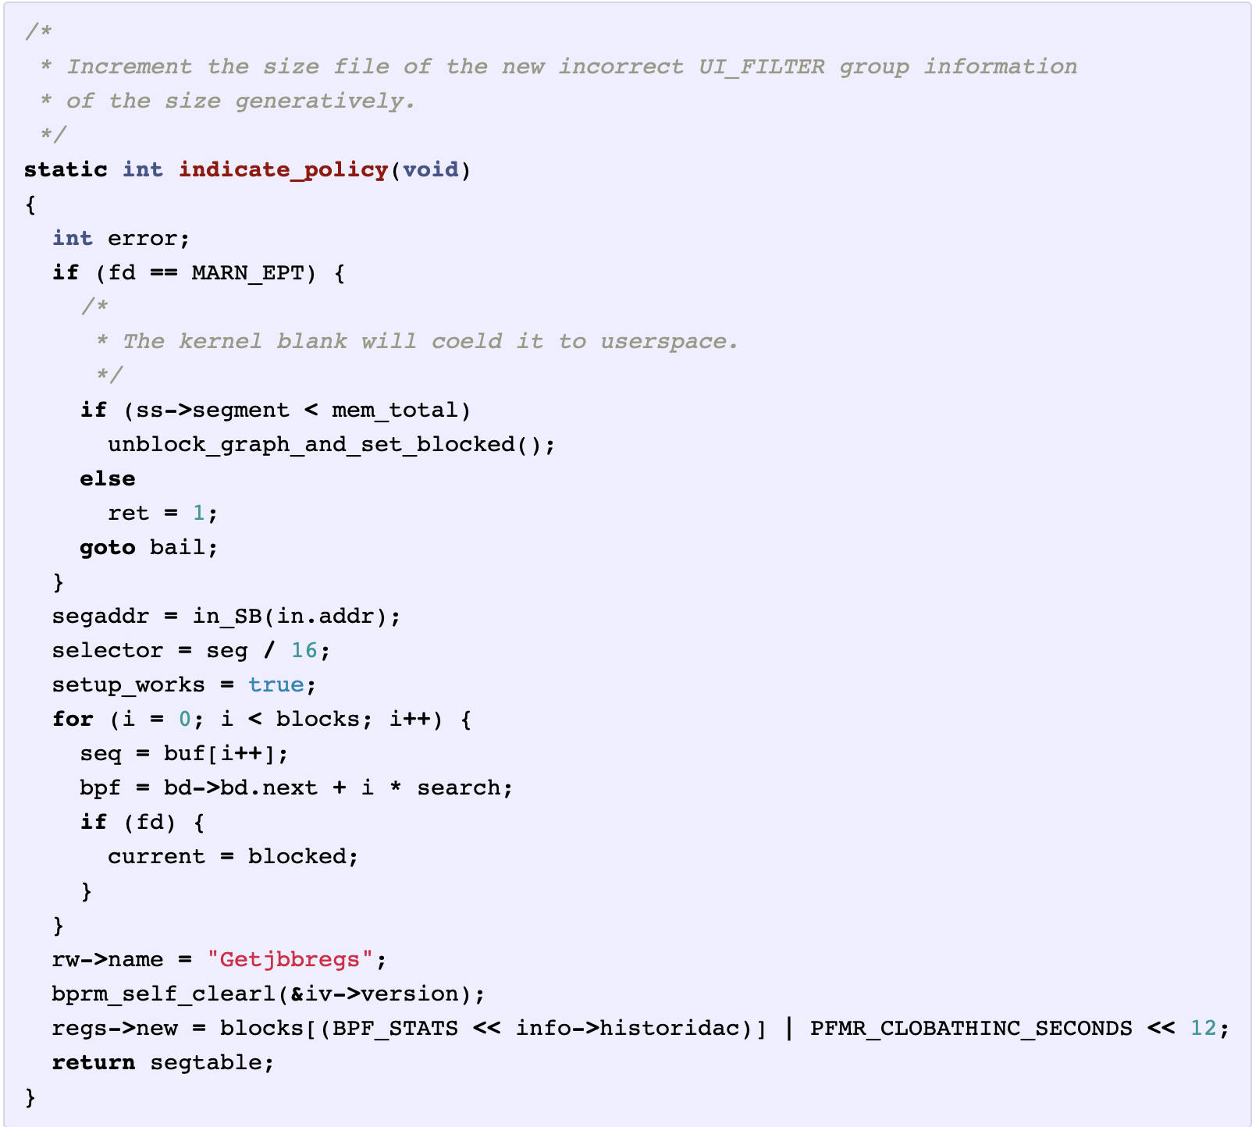
LM examples
http://karpathy.github.io/2015/05/21/rnn-effectiveness/

Slide 35
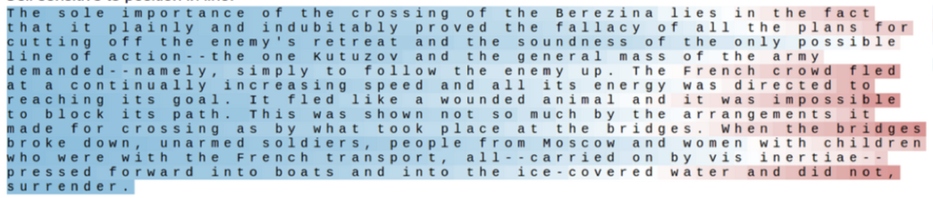
https://arxiv.org/pdf/1506.02078.pdf

Slide 36
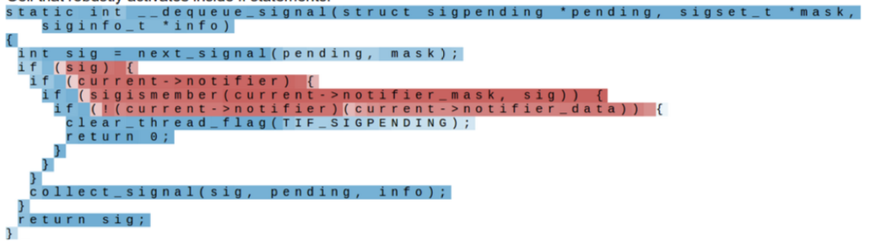
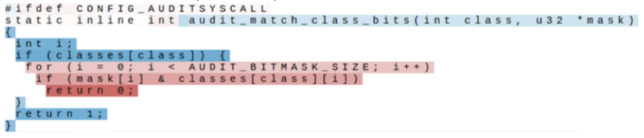
https://arxiv.org/pdf/1506.02078.pdf

